Slide 1



PreProcess
DetProcess
PostProcess
read_queue
pre_queue
det_queue
post_queue
put
...
get
put
...
get
put
...
get
put
...

Slide 2
Process 1
Process 2
PreProcess
PostProcess
read_queue
pre_queue
post_queue
put
get
put
...
get
put
...
...
det_queue
get
put
...
Main Process:Detection
model

Slide 3
Process 3
Process 1
Process 2
pre
det
post
read_queue
get
put
show_queue
put
...
Process 4
...
get
get
put
pre
det
post
get
put
put
......
get
Process n
pre
det
post

Slide 4
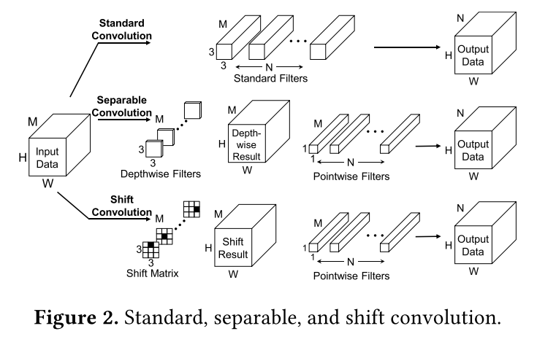

Slide 5
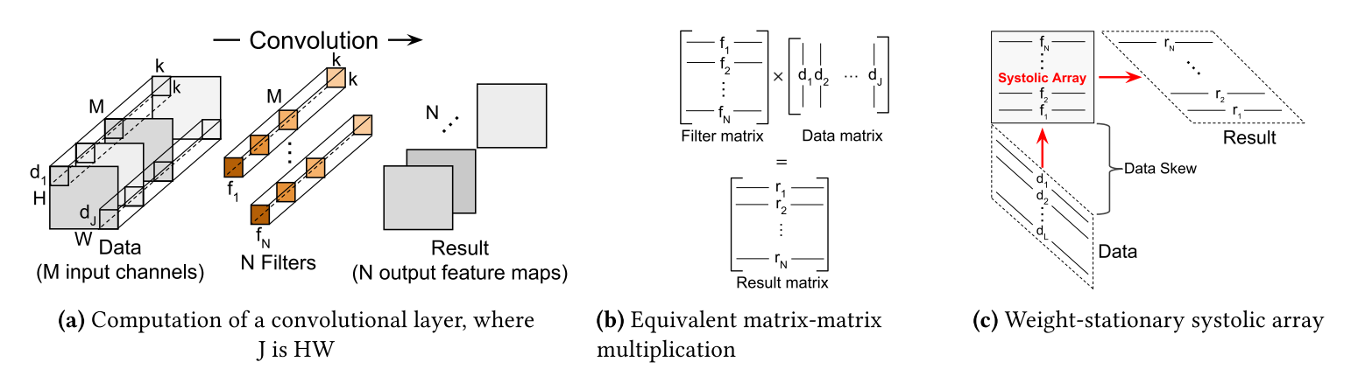

Slide 6
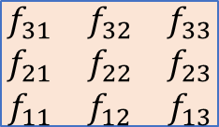

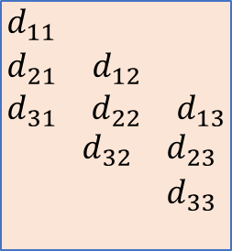
$$\begin{matrix}f_{31} & f_{32} & f_{33} \\ f_{21} & f_{22} & f_{23} \\ f_{11} & f_{12} & f_{13}\end{matrix}$$
$$\begin{matrix}d_{11} & & \\ d_{21} & d_{12} & \\ d_{31} & d_{22} & d_{13}\end{matrix}$$
$$\begin{matrix} & d_{32} & d_{23} \\ & & d_{33} \\ & & \end{matrix}$$

